Slide 1
Data Mining Classification: Alternative Techniques
Imbalanced Class Problem

Slide 2
Class Imbalance Problem
Lots of classification problems where the classes are skewed (more records from one class than another)
Credit card fraud
Intrusion detection
Defective products in manufacturing assembly line
COVID-19 test results on a random sample
Key Challenge:
Evaluation measures such as accuracy are not well-suited for imbalanced class

Slide 3
Confusion Matrix
Confusion Matrix:
 | PREDICTED CLASS
ACTUAL CLASS |  | Class=Yes | Class=No
 | Class=Yes | a | b
 | Class=No | c | d
a: TP (true positive)
b: FN (false negative)
c: FP (false positive)
d: TN (true negative)

Slide 4
Accuracy
Most widely-used metric:
 | PREDICTED CLASS
ACTUAL CLASS |  | Class=Yes | Class=No
 | Class=Yes | a (TP) | b (FN)
 | Class=No | c (FP) | d (TN)

Slide 5
Problem with Accuracy
Consider a 2-class problem
Number of Class NO examples = 990
Number of Class YES examples = 10
If a model predicts everything to be class NO, accuracy is 990/1000 = 99 %
This is misleading because this trivial model does not detect any class YES example
Detecting the rare class is usually more interesting (e.g., frauds, intrusions, defects, etc)
 | PREDICTED CLASS
ACTUAL CLASS |  | Class=Yes | Class=No
 | Class=Yes | 0 | 10
 | Class=No | 0 | 990

Slide 6
Which model is better?
 | PREDICTED
ACTUAL |  | Class=Yes | Class=No
 | Class=Yes | 0 | 10
 | Class=No | 0 | 990
A
Accuracy: 99%
 | PREDICTED
ACTUAL |  | Class=Yes | Class=No
 | Class=Yes | 10 | 0
 | Class=No | 500 | 490
B
Accuracy: 50%

Slide 7
Which model is better?
 | PREDICTED
ACTUAL |  | Class=Yes | Class=No
 | Class=Yes | 5 | 5
 | Class=No | 0 | 990
A
B
 | PREDICTED
ACTUAL |  | Class=Yes | Class=No
 | Class=Yes | 10 | 0
 | Class=No | 500 | 490

Slide 8
Alternative Measures
 | PREDICTED CLASS
ACTUAL CLASS |  | Class=Yes | Class=No
 | Class=Yes | a | b
 | Class=No | c | d
The recall is the measure of our model correctly identifying True Positives. Thus, for all the patients who actually have heart disease, recall tells us how many we correctly identified as having a heart disease
Notes:
Right – so now we come to the crux of this article. What in the world is Precision? And what does all the above learning have to do with it?
In the simplest terms, Precision is the ratio between the True Positives and all the Positives. For our problem statement, that would be the measure of patients that we correctly identify as having a heart disease out of all the patients actually having it. Mathematically:
The recall is the measure of our model correctly identifying True Positives. Thus, for all the patients who actually have heart disease, recall tells us how many we correctly identified as having a heart disease. Mathematically:

Slide 9
Alternative Measures
 | PREDICTED CLASS
ACTUAL CLASS |  | Class=Yes | Class=No
 | Class=Yes | 10 | 0
 | Class=No | 10 | 980
Although we do aim for high precision and high recall value, achieving both at the same time is not possible. For example, if we change the model to one giving us a high recall, we might detect all the patients who actually have heart disease, but we might end up giving treatments to many patients who don’t suffer from it.
Similarly, suppose we aim for high precision to avoid giving any wrong and unrequired treatment. In that case, we end up getting a lot of patients who actually have heart disease going without any treatment.
Notes:
Although we do aim for high precision and high recall value, achieving both at the same time is not possible. For example, if we change the model to one giving us a high recall, we might detect all the patients who actually have heart disease, but we might end up giving treatments to many patients who don’t suffer from it.
Similarly, suppose we aim for high precision to avoid giving any wrong and unrequired treatment. In that case, we end up getting a lot of patients who actually have heart disease going without any treatment.

Slide 10
Alternative Measures
 | PREDICTED CLASS
ACTUAL CLASS |  | Class=Yes | Class=No
 | Class=Yes | 10 | 0
 | Class=No | 10 | 980
 | PREDICTED CLASS
ACTUAL CLASS |  | Class=Yes | Class=No
 | Class=Yes | 1 | 9
 | Class=No | 0 | 990

Slide 11
Which of these classifiers is better?
 | PREDICTED CLASS
ACTUAL CLASS |  | Class=Yes | Class=No
 | Class=Yes | 40 | 10
 | Class=No | 10 | 40
A
B
 | PREDICTED CLASS
ACTUAL CLASS |  | Class=Yes | Class=No
 | Class=Yes | 40 | 10
 | Class=No | 1000 | 4000
Notes:
For example, for our dataset, we can consider that achieving a high recall is more important than getting a high precision – we would like to detect as many heart patients as possible. For some other models, like classifying whether or not a bank customer is a loan defaulter, it is desirable to have high precision since the bank wouldn’t want to lose customers who were denied a loan based on the model’s prediction that they would be defaulters.
There are also many situations where precision and recall are equally important. For example, for our model, if the doctor informs us that the patients who were incorrectly classified as suffering from heart disease are equally important since they could be indicative of some other ailment, then we would aim for not only a high recall but a high precision as well.

Slide 12
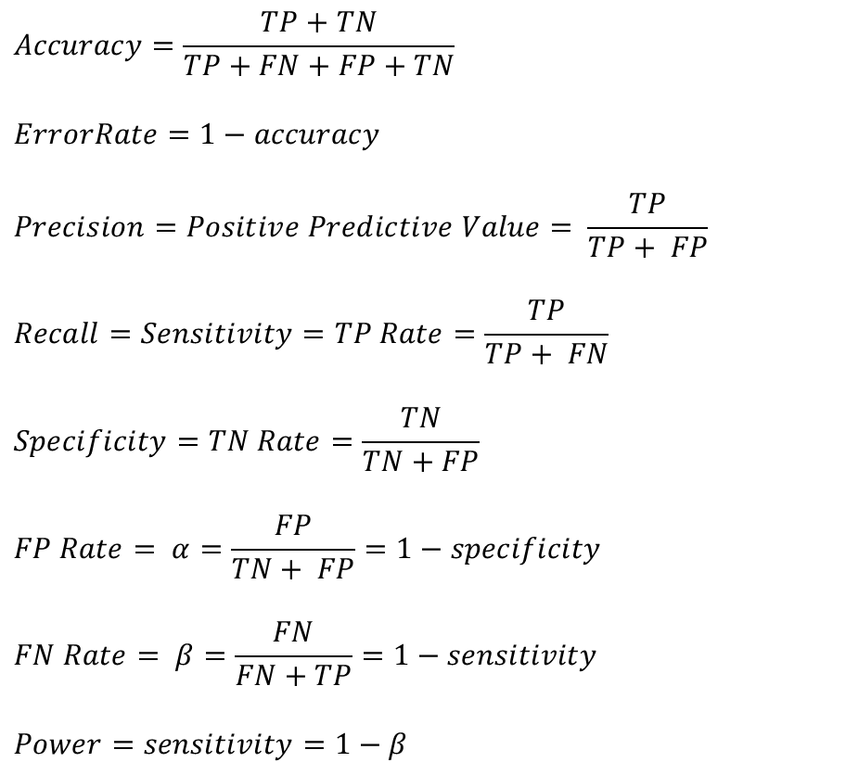
Measures of Classification Performance
 | PREDICTED CLASS
ACTUAL CLASS |  | Yes | No
 | Yes | TP | FN
 | No | FP | TN
α is the probability that we reject the null hypothesis when it is true. This is a Type I error or a false positive (FP).
β is the probability that we accept the null hypothesis when it is false. This is a Type II error or a false negative (FN).
F1score = 2pr / (p+r)
Notes:
The null hypothesis is the statement or claim being made (which we are trying to disprove) and the alternative hypothesis is the hypothesis that we are trying to prove and which is accepted if we have sufficient evidence to reject the null hypothesis.

Slide 13

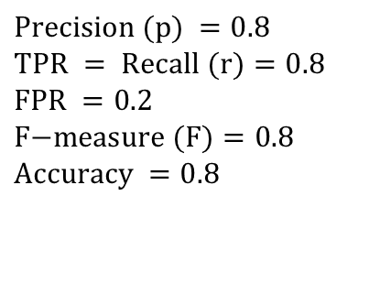

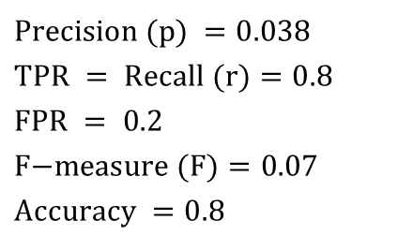
Alternative Measures
A | PREDICTED CLASS
ACTUAL CLASS |  | Class=Yes | Class=No
 | Class=Yes | 40 | 10
 | Class=No | 10 | 40
$$\text{Precision} (p) =0.8 \\ \text{TPR} = \text{Recall} (r)=0.8 \\ \text{FPR} =0.2 \\ \text{F}\text{−}\text{measure} (F)=0.8 \\ \text{Accuracy} =0.8$$
$$\frac{TPR}{FPR}=4$$
B | PREDICTED CLASS
ACTUAL CLASS |  | Class=Yes | Class=No
 | Class=Yes | 40 | 10
 | Class=No | 1000 | 4000
$$\text{Precision} (p) =0.038 \\ \text{TPR} = \text{Recall} (r)=0.8 \\ \text{FPR} =\text{ 0.2} \\ \text{F}\text{−}\text{measure} (F)=0.07 \\ \text{Accuracy} =0.8$$
$$\frac{TPR}{FPR}=4$$
Notes:
TP/TP+FN
FP/FP+TN

Slide 14
Which of these classifiers is better?
A | PREDICTED CLASS
ACTUAL CLASS |  | Class=Yes | Class=No
 | Class=Yes | 10 | 40
 | Class=No | 10 | 40
B | PREDICTED CLASS
ACTUAL CLASS |  | Class=Yes | Class=No
 | Class=Yes | 25 | 25
 | Class=No | 25 | 25
C | PREDICTED CLASS
ACTUAL CLASS |  | Class=Yes | Class=No
 | Class=Yes | 40 | 10
 | Class=No | 40 | 10

Slide 15
ROC (Receiver Operating Characteristic)
A graphical approach for displaying trade-off between detection rate and false alarm rate
Developed in 1950s for signal detection theory to analyze noisy signals
ROC curve plots TPR against FPR
Performance of a model represented as a point in an ROC curve

Slide 16
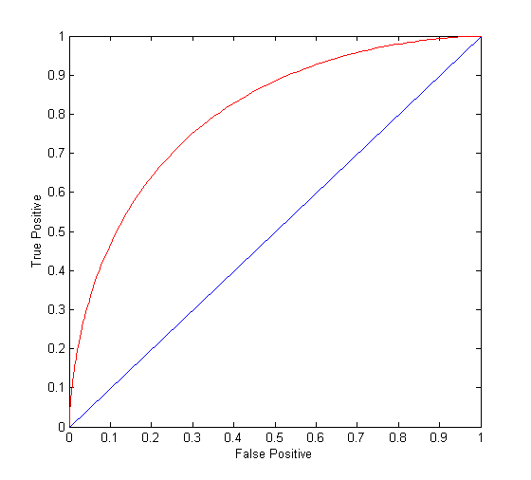
ROC Curve
(TPR,FPR):
(0,0): declare everything to be negative class
(1,1): declare everything to be positive class
(1,0): ideal
Diagonal line:
Random guessing
Below diagonal line:
prediction is opposite of the true class

Slide 17
ROC (Receiver Operating Characteristic)
To draw ROC curve, classifier must produce continuous-valued output
Outputs are used to rank test records, from the most likely positive class record to the least likely positive class record
By using different thresholds on this value, we can create different variations of the classifier with TPR/FPR tradeoffs
Many classifiers produce only discrete outputs (i.e., predicted class)
How to get continuous-valued outputs?
Decision trees, rule-based classifiers, neural networks, Bayesian classifiers, k-nearest neighbors, SVM

Slide 18
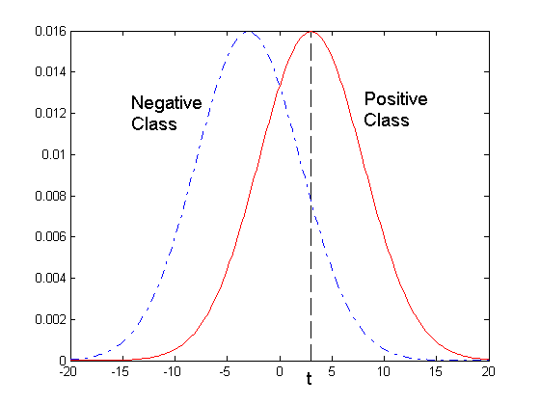
ROC Curve Example
- 1-dimensional data set containing 2 classes (positive and negative)
- Any points located at x > t is classified as positive
At threshold t:
TPR=0.5, FNR=0.5, FPR=0.12, TNR=0.88

Slide 19
Dealing with Imbalanced Classes - Summary
Many measures exists, but none of them may be ideal in all situations
Random classifiers can have high value for many of these measures
TPR/FPR provides important information but may not be sufficient by itself in many practical scenarios
Given two classifiers, sometimes you can tell that one of them is strictly better than the other
C1 is strictly better than C2 if C1 has strictly better TPR and FPR relative to C2 (or same TPR and better FPR, and vice versa)
Even if C1 is strictly better than C2, C1’s F-value can be worse than C2’s if they are evaluated on data sets with different imbalances
Classifier C1 can be better or worse than C2 depending on the scenario at hand (class imbalance, importance of TP vs FP, cost/time tradeoffs)

Slide 20
Which Classifier is better? High Skew case
T1 | PREDICTED CLASS
ACTUAL CLASS |  | Class=Yes | Class=No
 | Class=Yes | 50 | 50
 | Class=No | 100 | 9900
T2 | PREDICTED CLASS
ACTUAL CLASS |  | Class=Yes | Class=No
 | Class=Yes | 99 | 1
 | Class=No | 1000 | 9000
T3 | PREDICTED CLASS
ACTUAL CLASS |  | Class=Yes | Class=No
 | Class=Yes | 99 | 1
 | Class=No | 100 | 9900

Slide 21
Building Classifiers with Imbalanced Training Set
Modify the distribution of training data so that rare class is well-represented in training set
Undersample the majority class
Oversample the rare class
SMOTE
SMOTENC
SMOTEN
BorderlineSMOTE etc

